Slide 1




Shenzhen DanEr Technology Co.,Ltd
Professional packaging manufacturer, providing Customized & OEM / ODM service
ADD:No38, Qinfu Road,Liyue Community, Henggang Street, Longgang District, Shenzhen City, In china
Phone : +86 13554855879/15989363280
Fax:
Email: Alisa@szdr-can.com
whatapp/skype: +86 13554855879/shushu0212

Slide 2
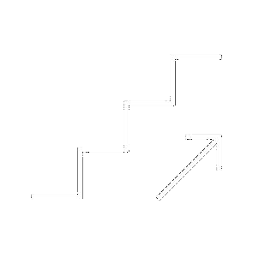




CONTENTS
Certifications
01
Company Introduction
02
03
Product Display
04
Order Form

Slide 3
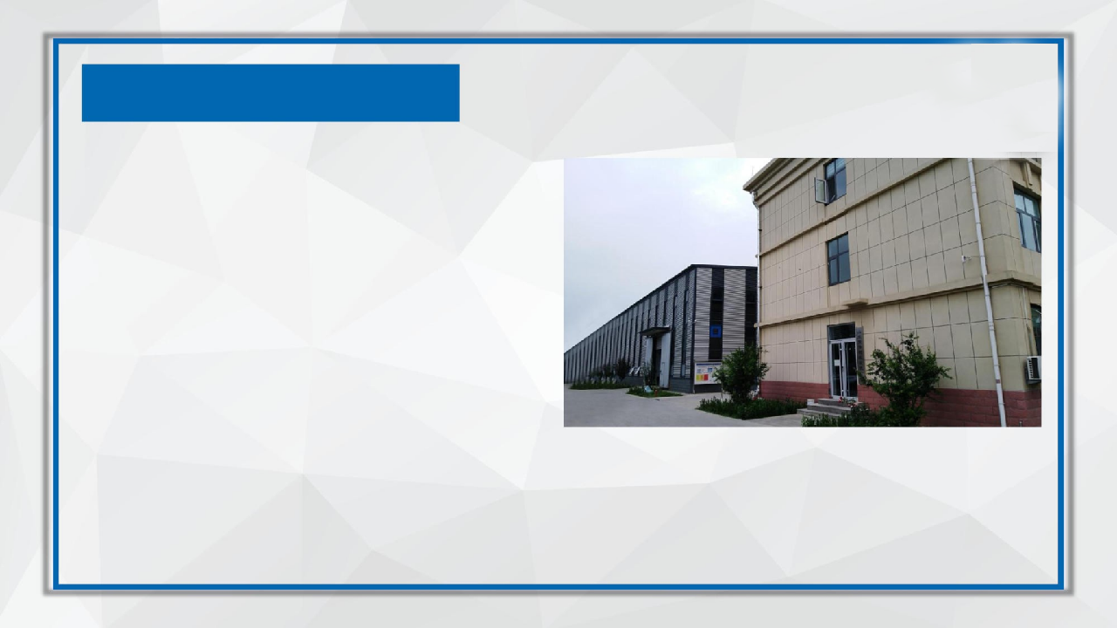
Company Introductions
Shenzhen daner technology co，ltd located in shenzhen city, Guangdong province, is a private enterprise, specialized in producing all kinds of packaging products, It was established in 2013, with registered capital of 300 million.
Any food packaging can be customized or processed,part free of charge
for customers to design, and make some samples
Our company has developed rapidly in recent years, with three own factories
(mold injection molding factory, metal packaging factory,
paper can box packaging factory) and a cooperative factory (glass factory).
Have their own technical research and development team,
Sales, design, production, R & D as one-stop of the supply chain,
More efficient production cost and delivery time savings
Our company has been certified by ISO9001: 200 13.Our products have good property
of abrasion resistance, rust proof and sealing stability, which meet national standard of Packing Containers for Packages of Dangerous Goods. Our company is not only the member of Association for Quality in Guangdong province,supporting many of International and domestic well-known enterprises.We, daner,
are well experienced in manufacturing food packaging. With high professional level in mechanic manufacturing and mature production techniques, and based on the
service tenet of "Customer-centered, Credit-based", we are increasingly innovating
and expanding. Since the establishment in the year of 2013, we have already had five canning production lines,10 injection equipments, Multiple paper cans manufacturing related equipment ,several productions for sundry cans and related supporting equipments, and meanwhile owned more than one hundred
different kinds of moulds for canning production. Our R&D center keeps developing
new products for customers. We have gained much more competitive advantages in production technology,
product quality, management, customers' satisfaction, etc, through the effort of new-product development from our R&D center and all staff.

Slide 4
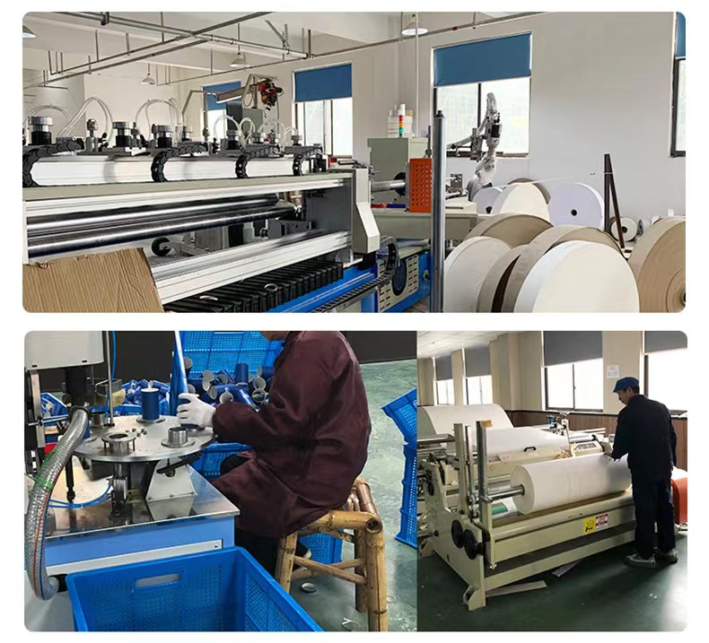
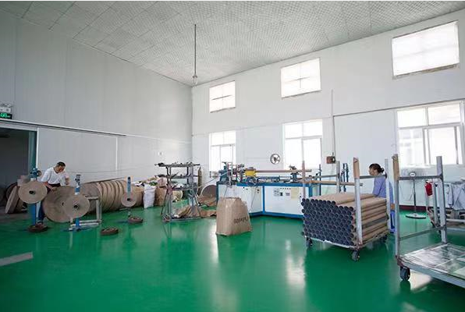
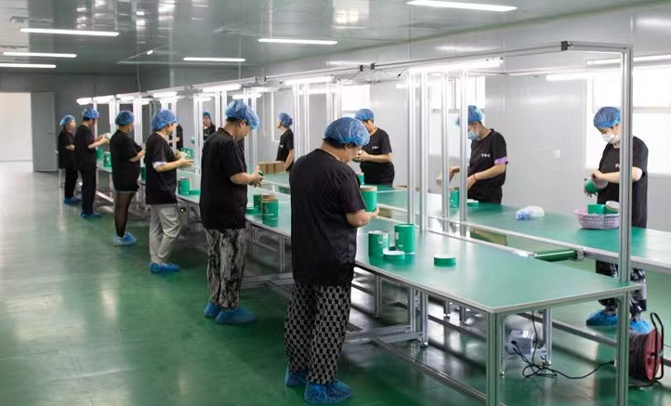
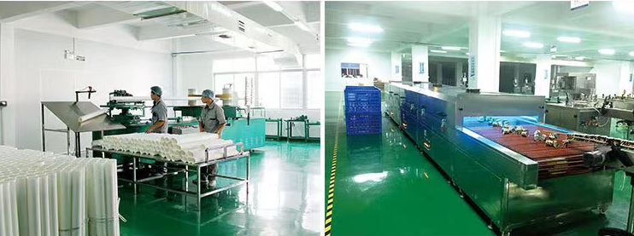
Workshop show

Slide 5
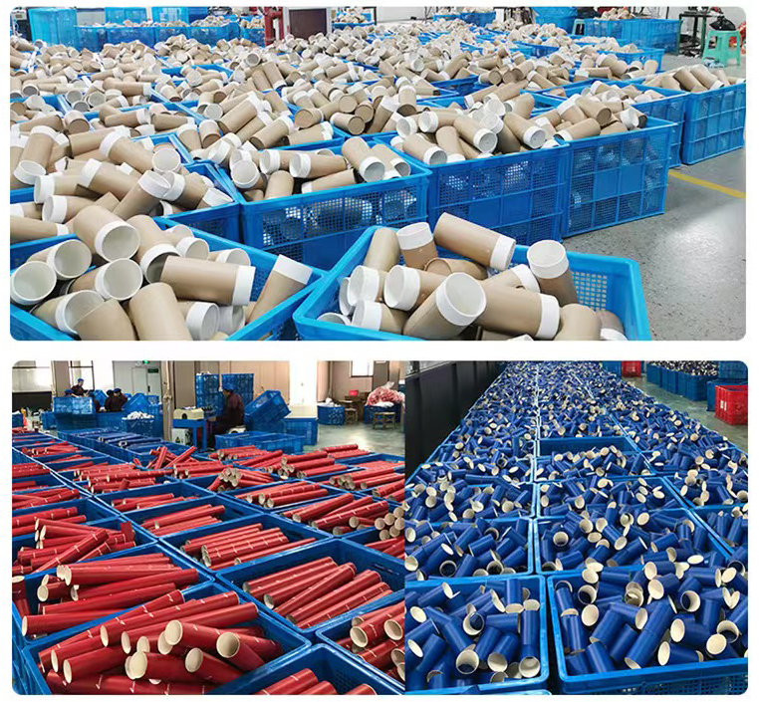
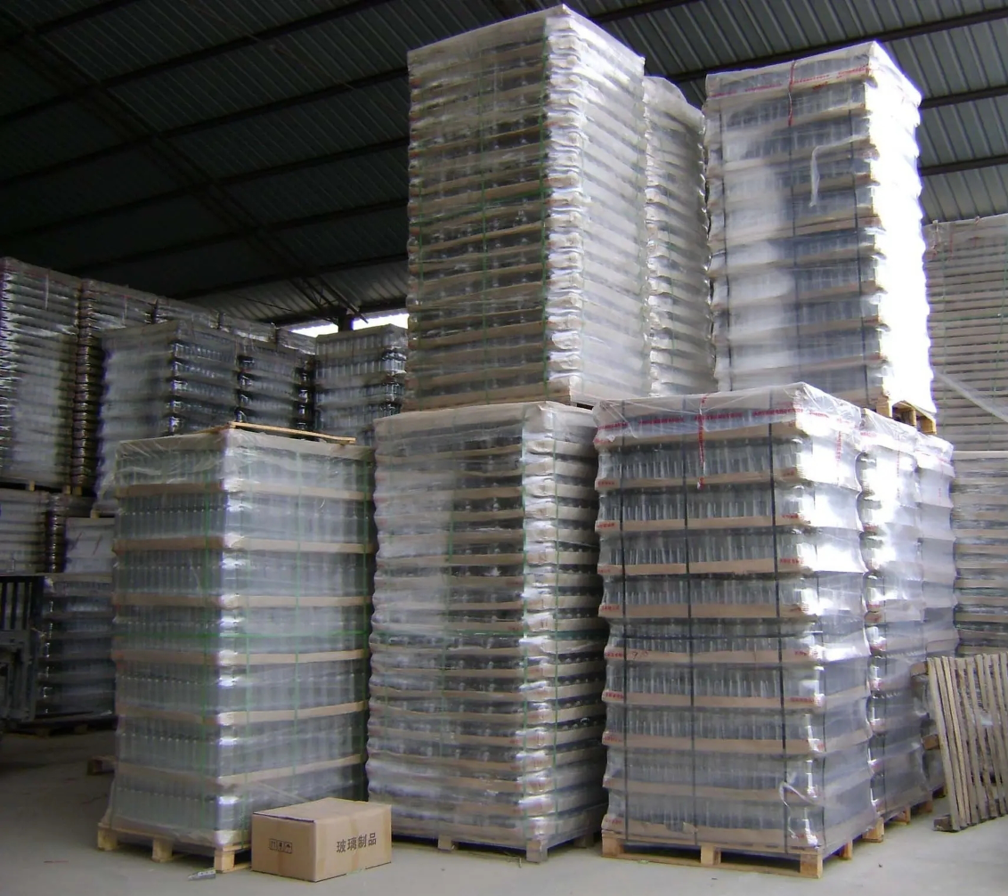
Warehous Display

Slide 6
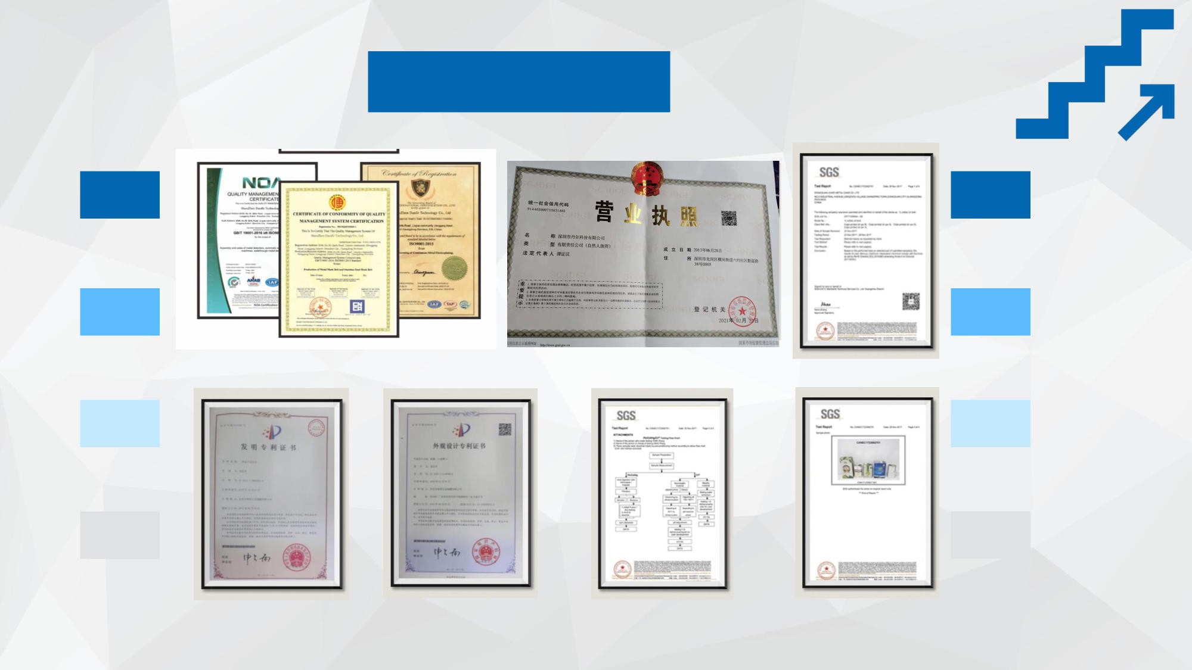
Certifications

Slide 7

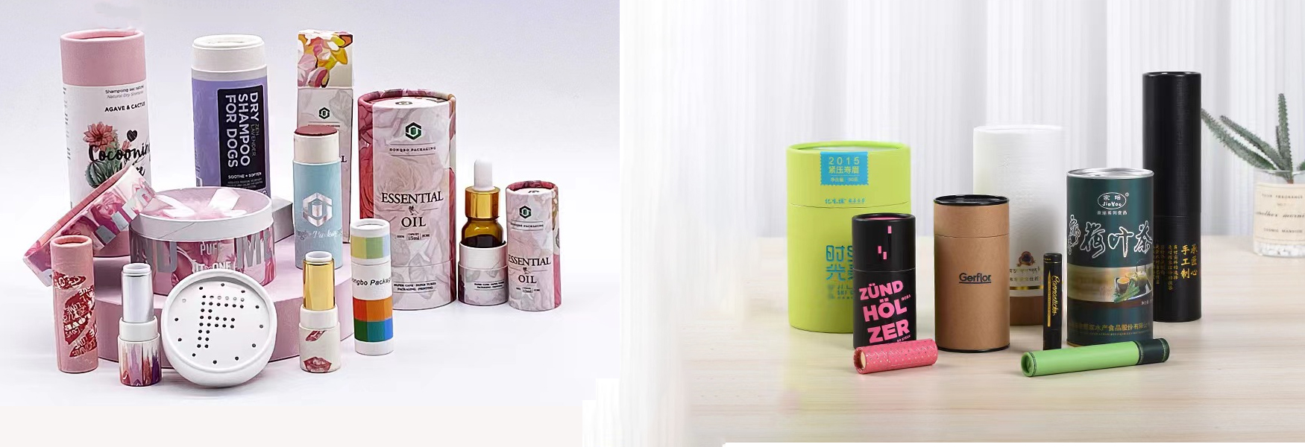
Paper Can Packaging Solutions

Slide 8
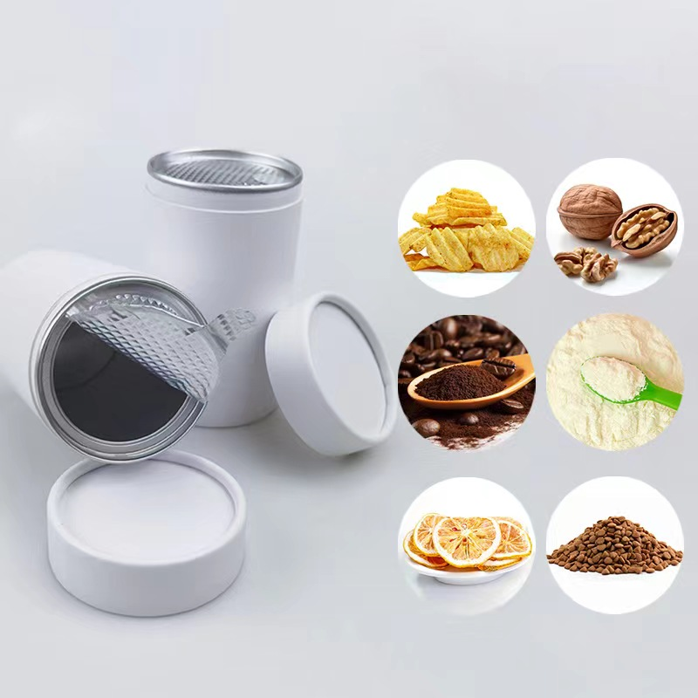
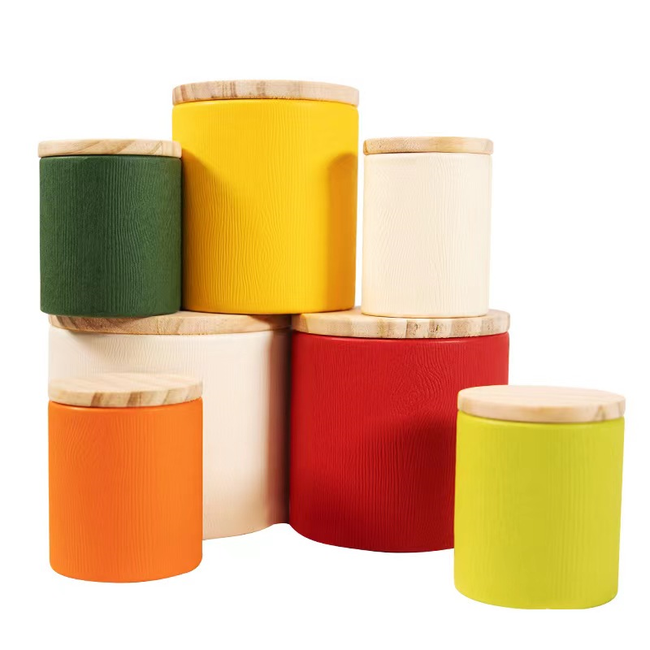
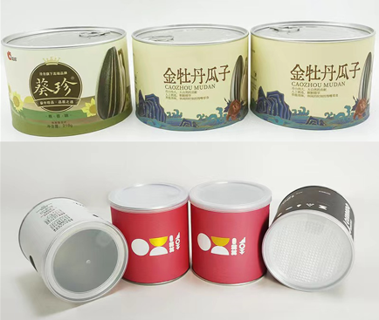
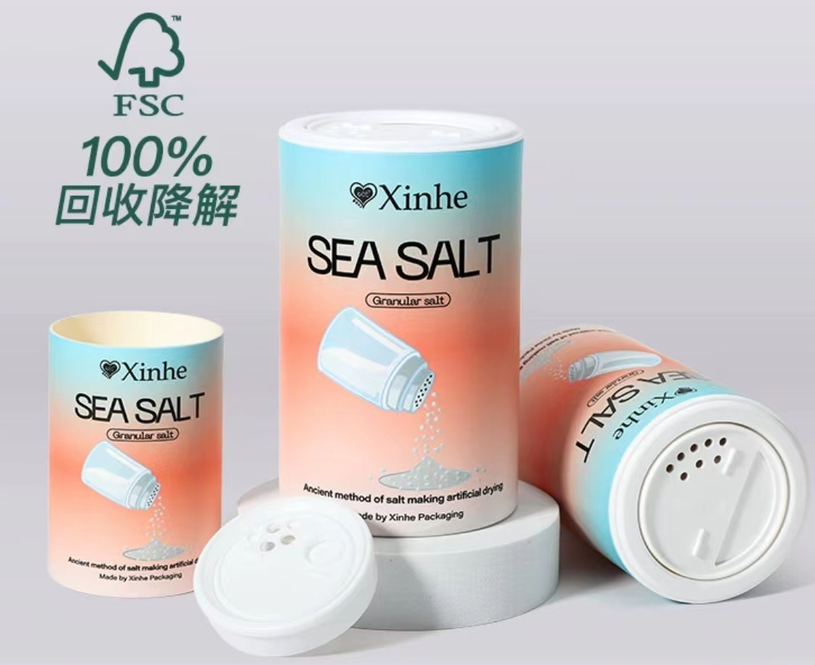
Paper Can for Series Food
(customized size and design/logo/labels)
round can（nuts/powder/snack ...)
round can
(flower/tea/spices/nuts)
round paper can
Round tin can
(Barbecue spices)
Dia63x H160mm
Dia66x H105mm
Dia89x H140mm
Dia105x H155mm
Customized size :
Dia Range:1.5cm-12cm
Height range:5cm-60cm
Thickness:2-3mm
250g :Dia85x H160mm
218g:Dia130x 95mm
D65xH95mm

Slide 9
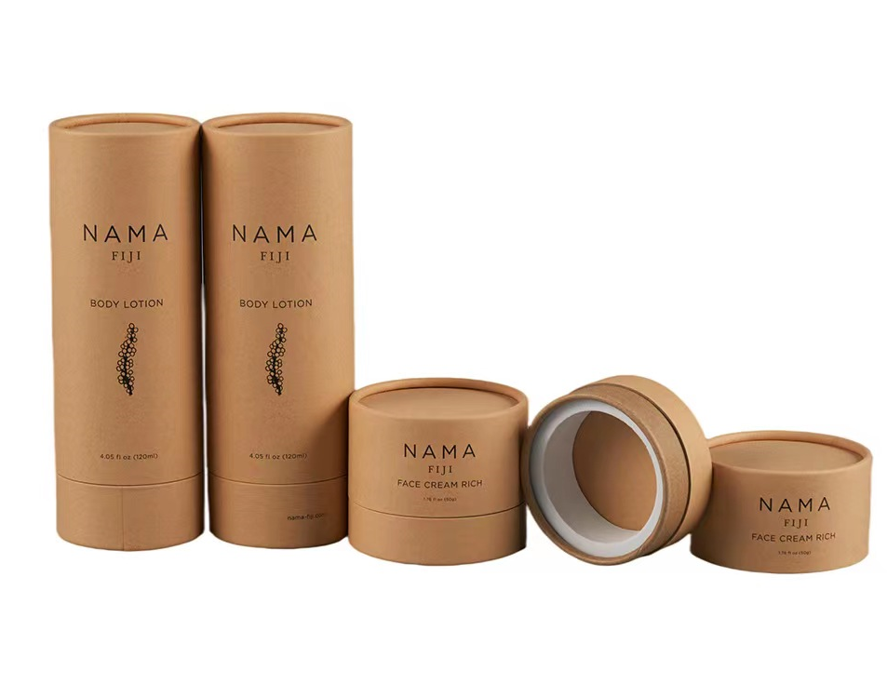
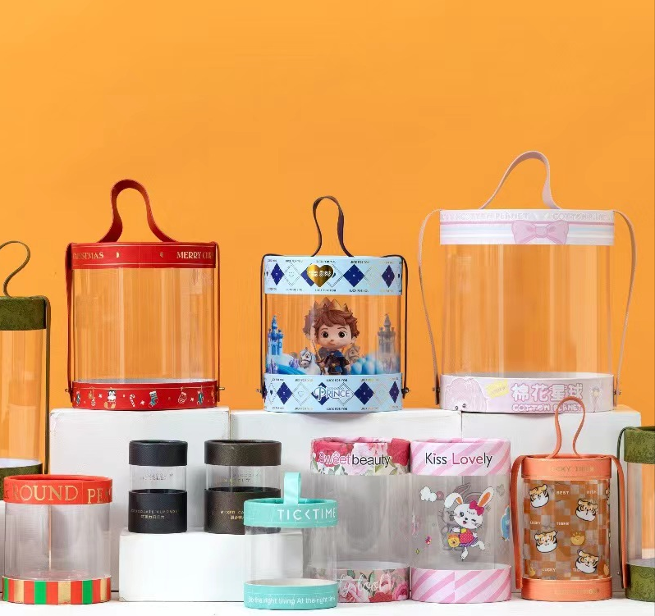
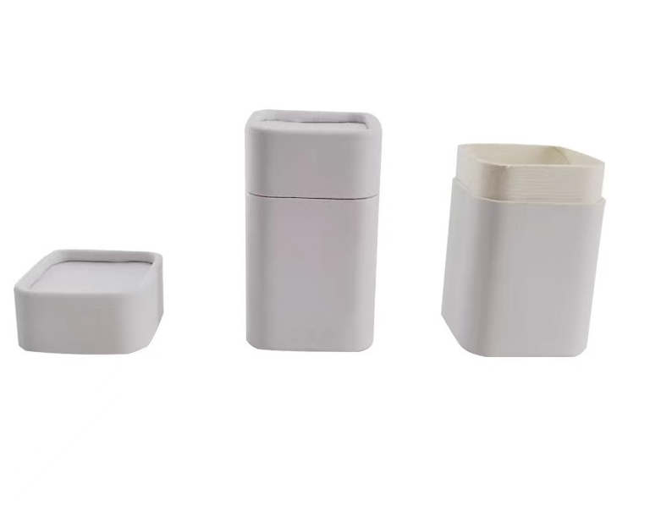
Paper Can Series
Hand gift box PVC bucket
paper can
Square paper can
customized size and styles | customized size and styles | customized size and styles

Slide 10
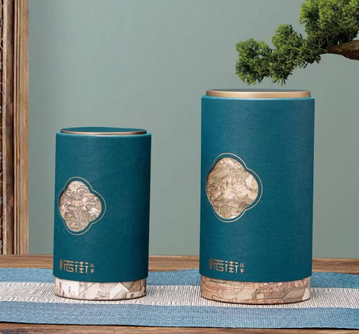
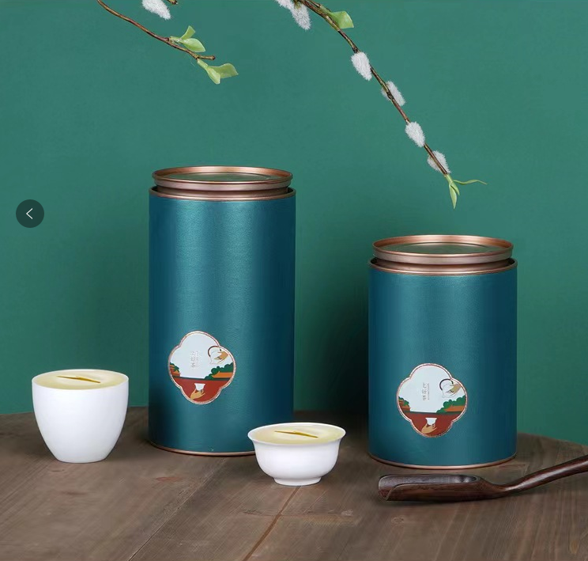
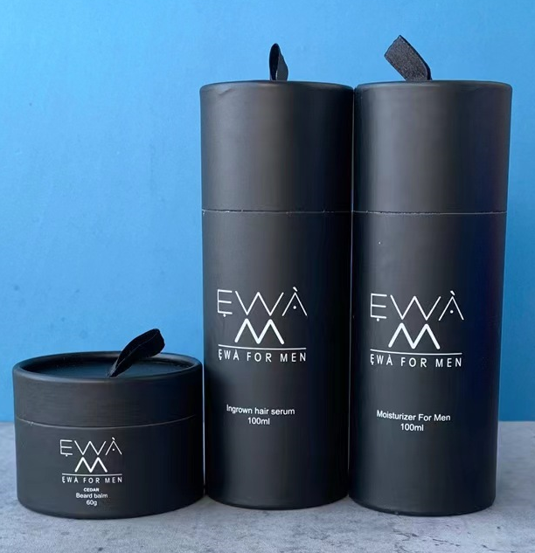
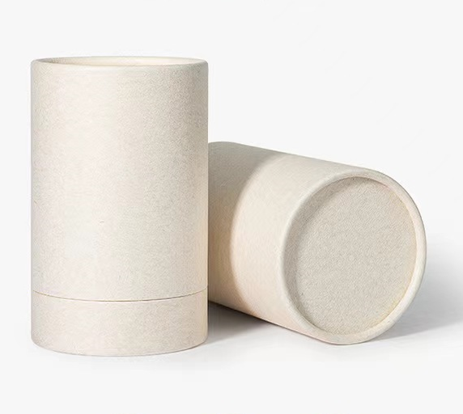
Paper Can
SIZE: Dia65*H90mm
SIZE: Dia65*H125mm
SIZE: Dia75*H13mm
SIZE: Dia85*H160mm
SIZE: Dia100*H190mm
SIZE: Dia110*H200mm
Dia83*H110mm
Dia83*H148mm
Dia100*H185mm
Dia105*H145mm
Dia105*H190mm
customized size

Slide 11
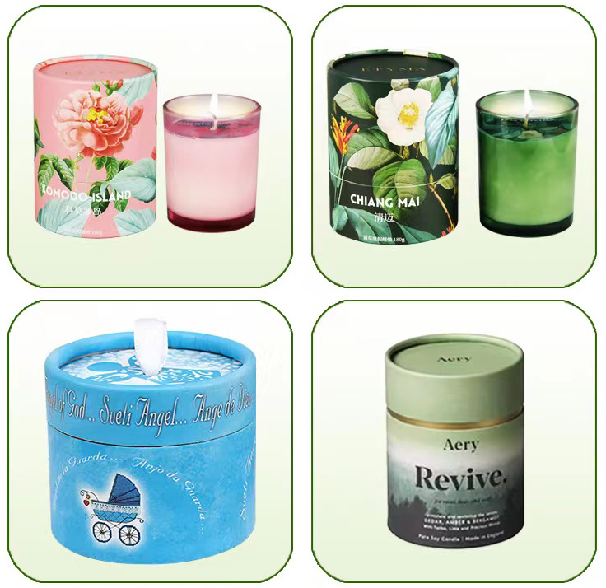
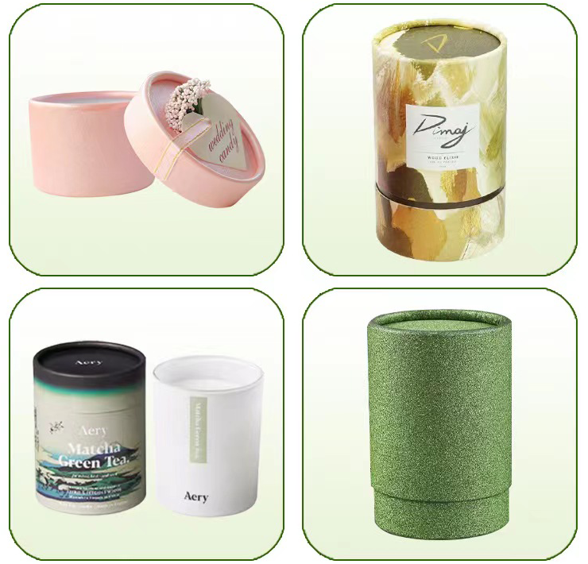
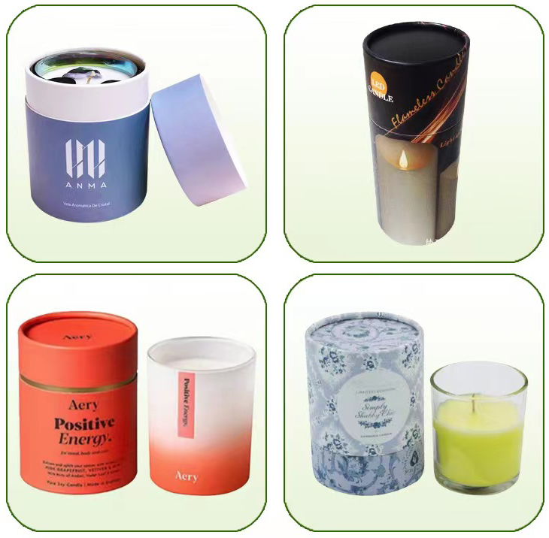
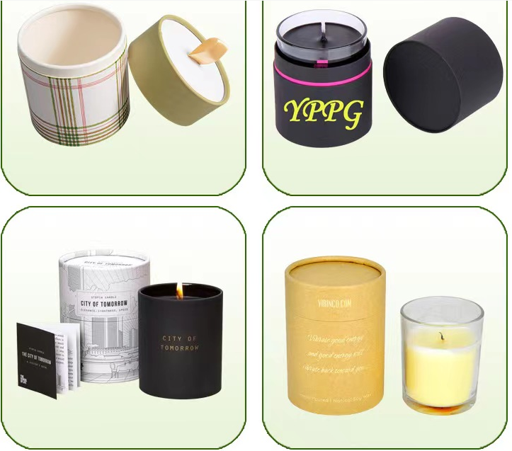
Aromatherapy oil Candles,Cosmetics

Slide 12
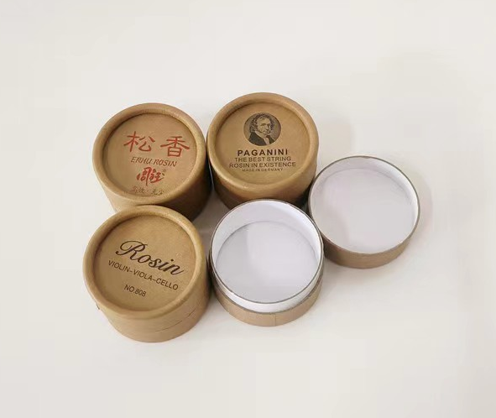




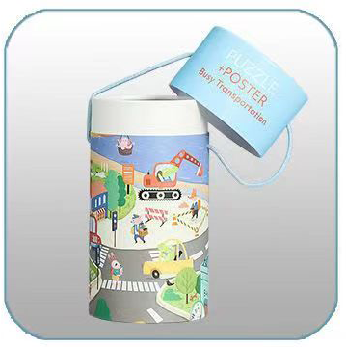




Aromatherapy oil Candles,Cosmetics

Slide 13
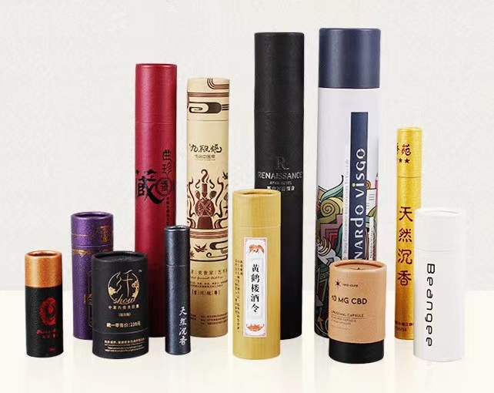
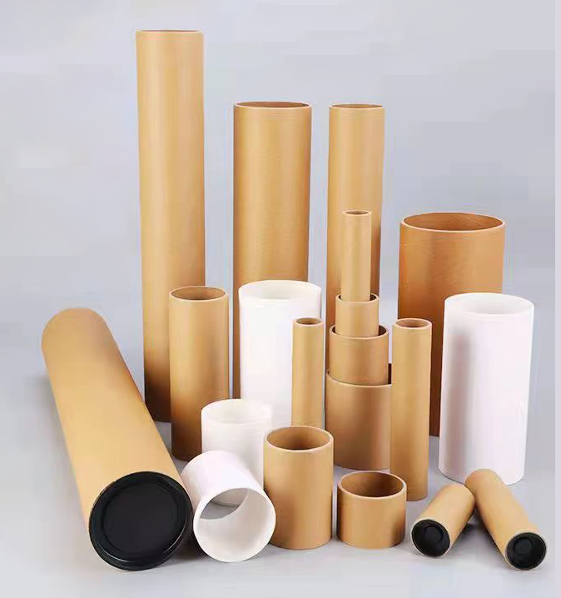
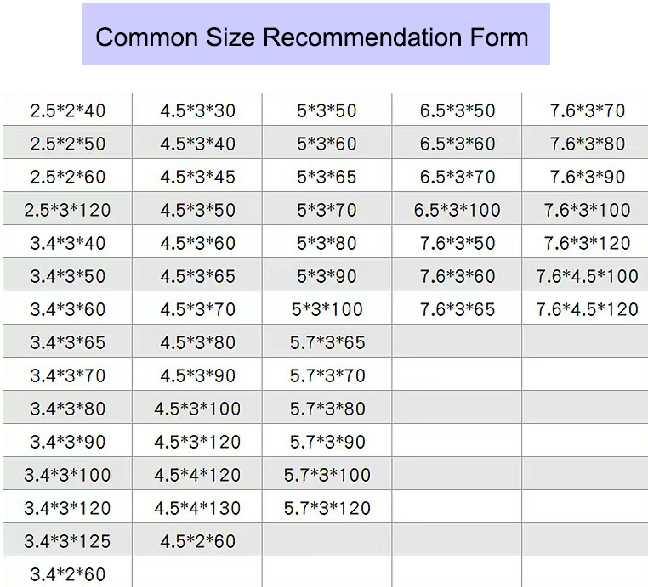
Perfume Candles paper can
welcome customized size range: Dia:15mm-100mm / Hieght:50mm-420mm)

Slide 14
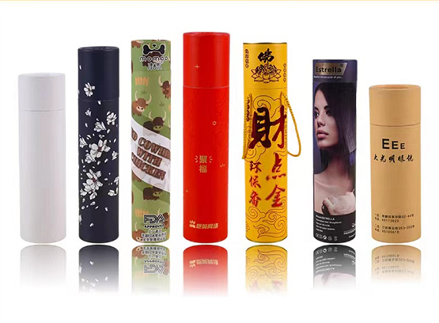
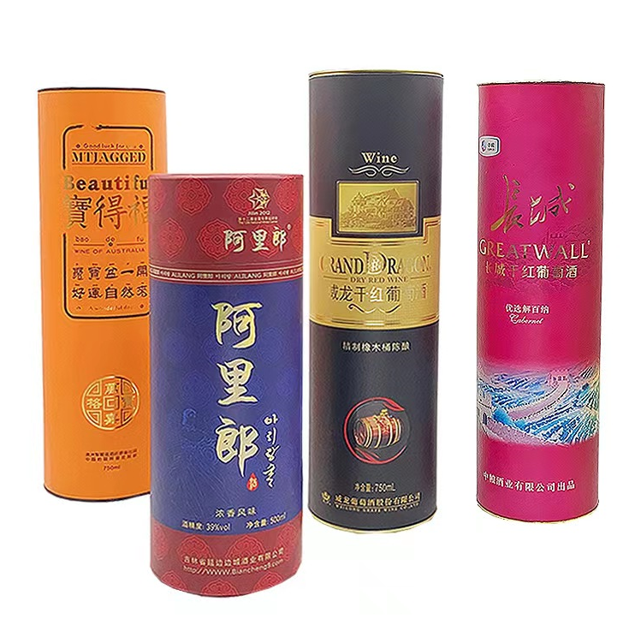
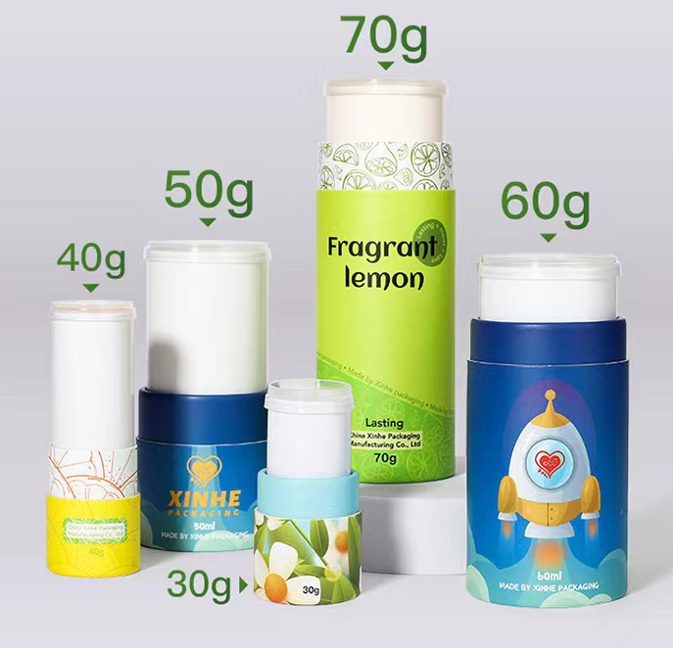

More Products Display
Spray series packaging
Wine series paper can
Paste packaging, the bottom
can be pushed and pulled
Drop liquid packaging

Slide 15
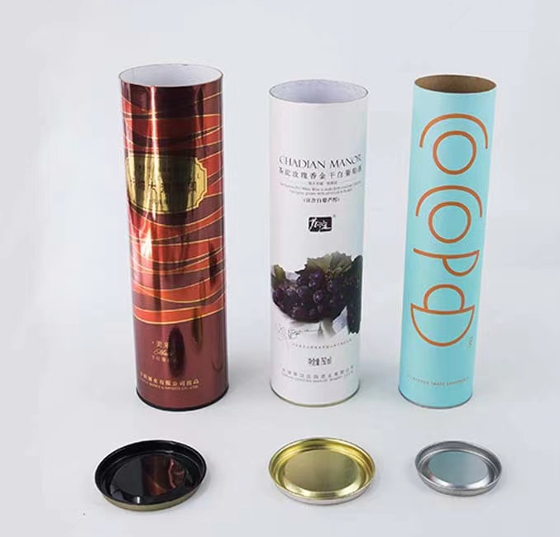
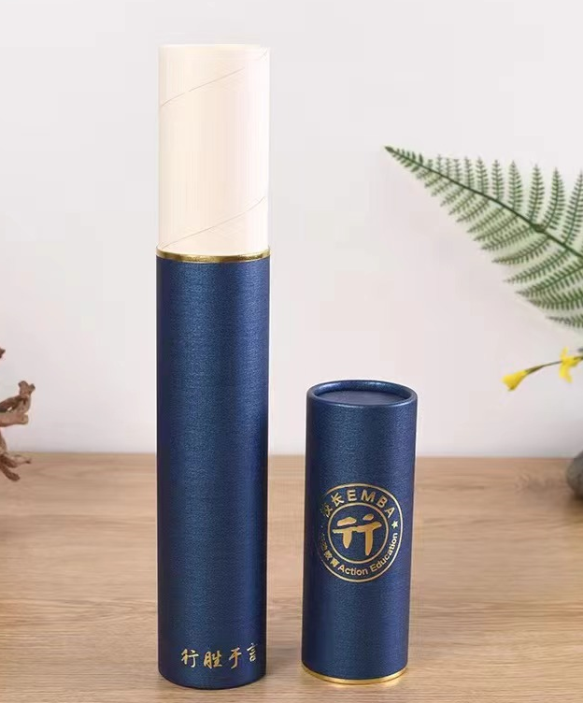
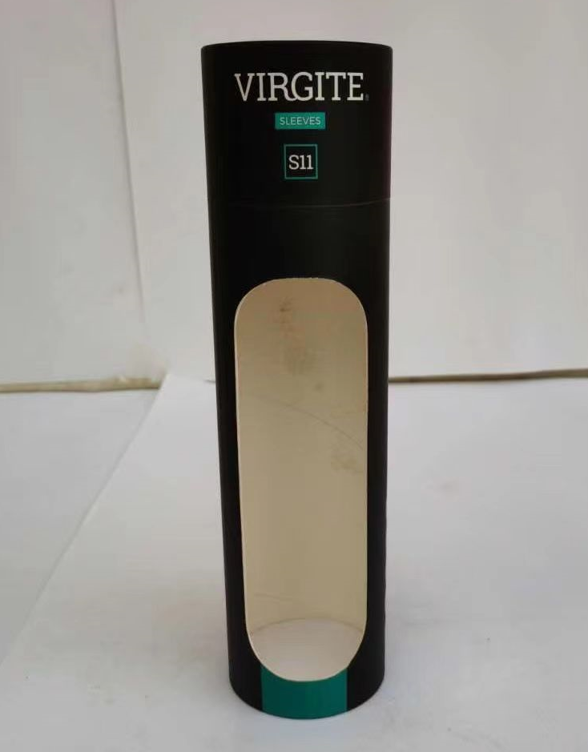
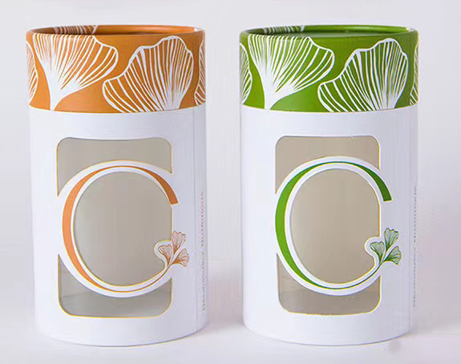
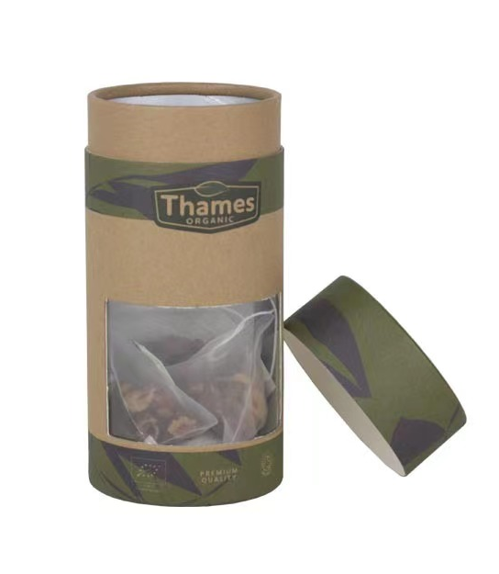
More Products Display
550mL
1L
Paper can
Window design + transparent PVC

Slide 16
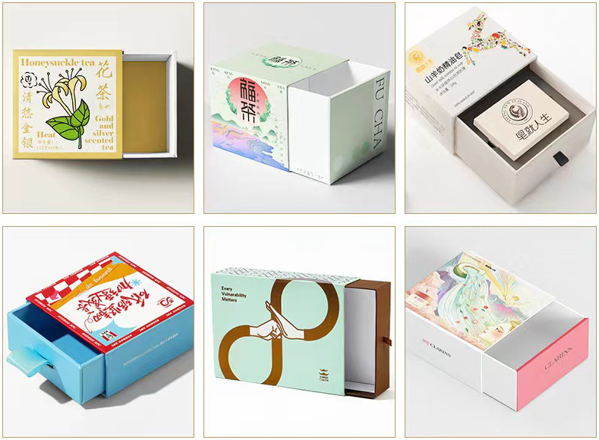
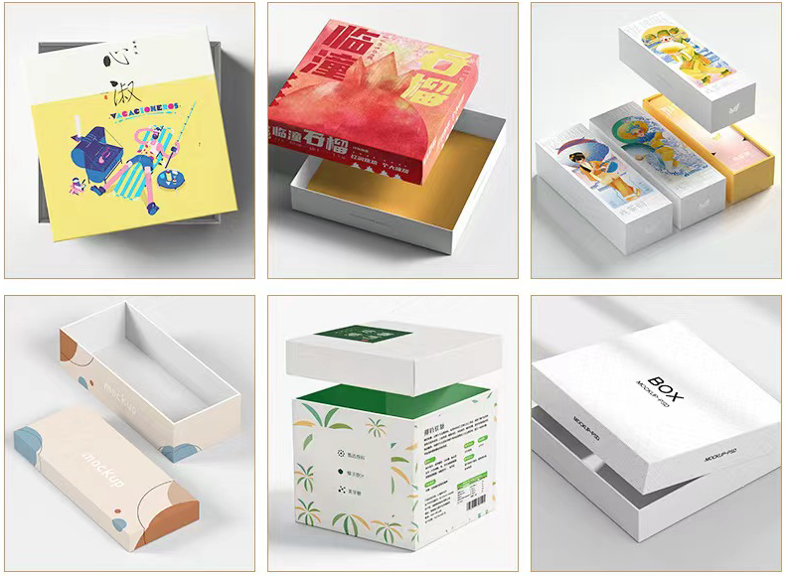
Paper box
1L
Drawer Box
Up and Down box

Slide 17
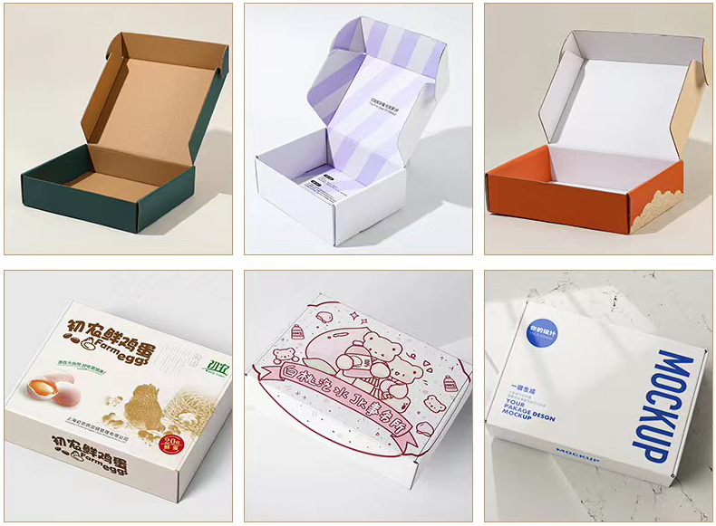
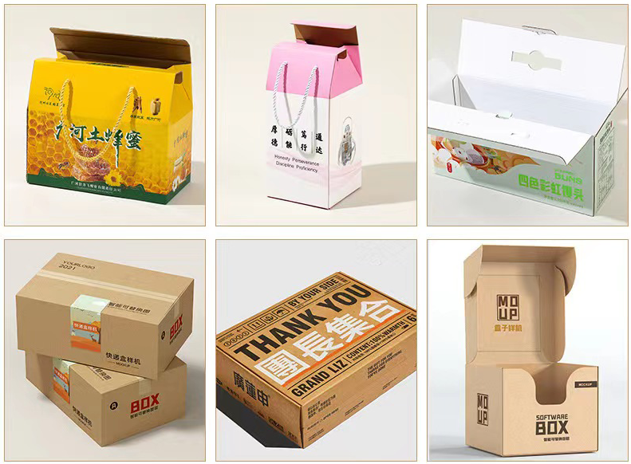
Paper box
1L
1L
Airplane box
Corrugated Box

Slide 18
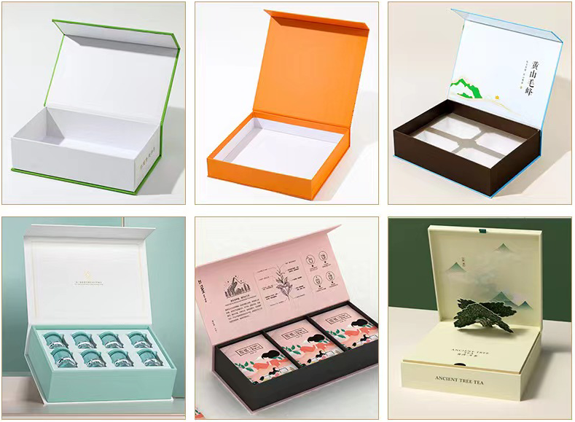
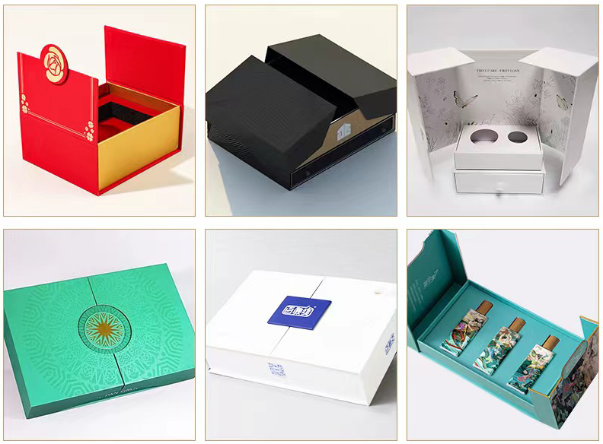
Paper box
Book Box
Double Open Box

Slide 19
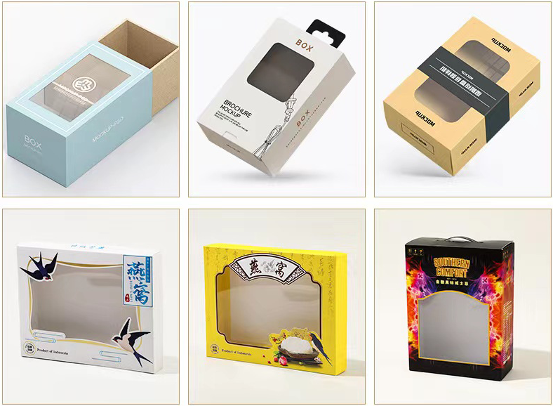
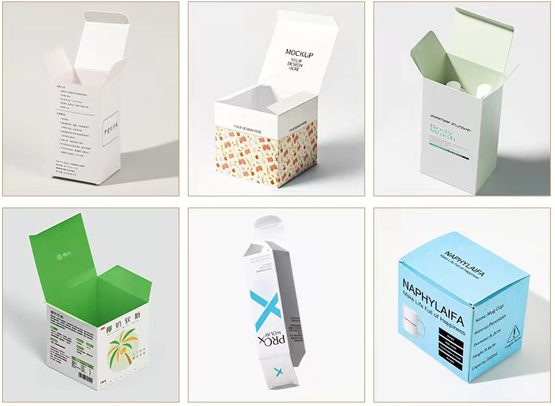
Paper box
Double Plug Box
Window box
Double Plug Box

Slide 20
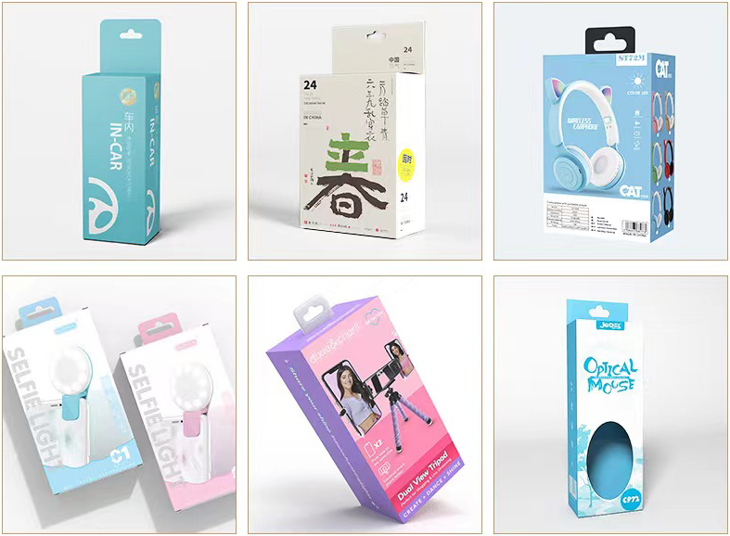
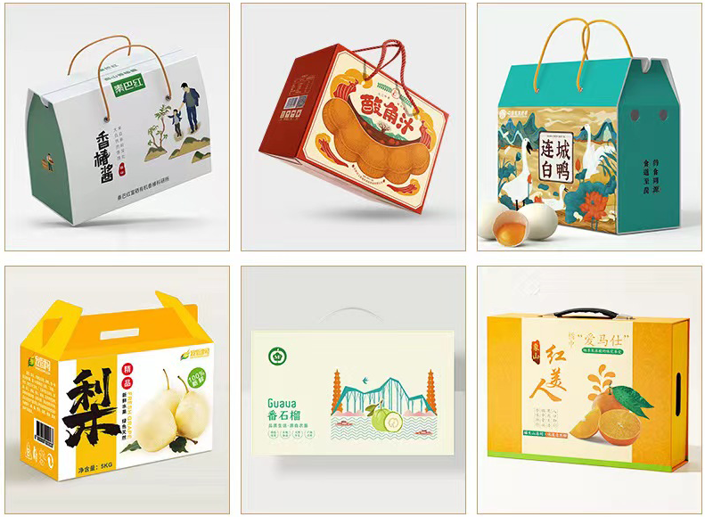
Paper box
Hook box
Hand Held Gift Box

Slide 21
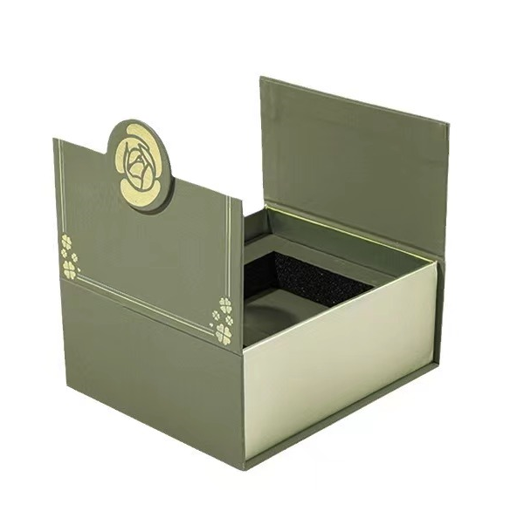
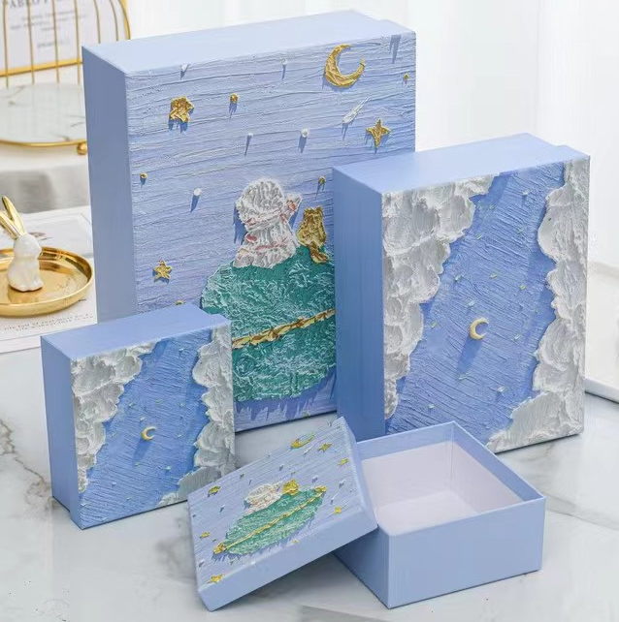

Creative Design Paper box

Slide 22

Paper Box Inner Tray

Slide 23

Customized Design Gift Paper Bags

Slide 24

Raw-material Choice

Slide 25

Printing Craft

Slide 26




Cover Choice

Slide 27

How to ordered
STEP 1 Choose the Box/can style (shape) and capacity you like and need, and tell us the quantity and printing requirements。
STEP 2
We provide design templates according to the style of your tin, please find a graphic designer and tell what you need, product name, brand, logo, etc. Design artwork will be made for you.
STEP 3
After the prepress department receives your design draft (Adobe Acrobat, or IIIustrator), our designers will adjust the design draft before printing, and then send the design draft back to you for confirmation. Our design department is happy to build electronic。
When you confirm the design drawings, we will restart the proofing or mass production.
STEP 4

Slide 28



